Slide 1
CP2404/CP5633 Database Modelling
Lecture 08

Slide 2
Lecture 8
Structured Query Language (SQL)
- Part 3 -
Reading: Coronel’s 12e Chapter 8.1 ~ 8.4
13e Chapter 8
Notes:
2

Slide 3
Learning Objectives
In this lecture, you will learn:
More practices of SQL
About the relational set operators UNION, UNION ALL, INTERSECT, and MINUS
How to use the advanced SQL JOIN operator syntax
Various types of subqueries and correlated queries
How to use SQL functions to manipulate dates, strings, and other data

Slide 4
Note:
Most SQL commands/scripts used in this lecture notes followed the standard ANSI SQL, thus some of them may not be compatible to every DBMS.

Slide 5
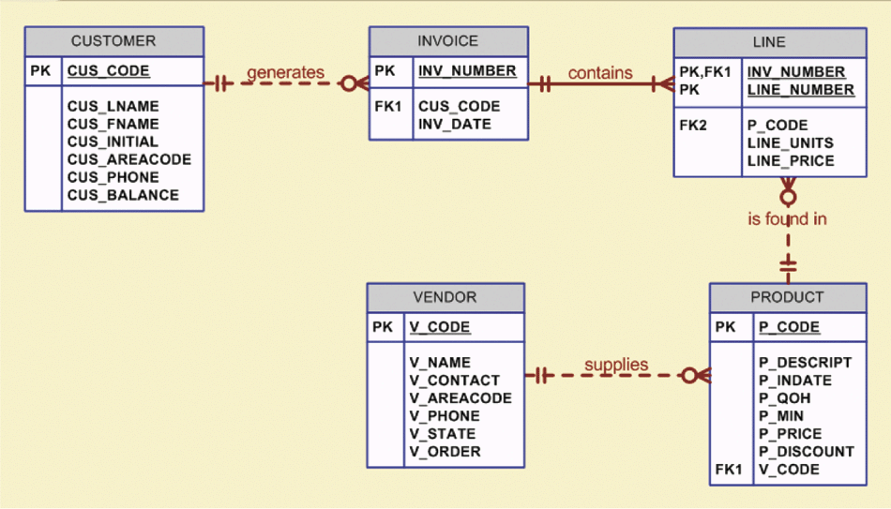
EXAMPLE: The Database Model

Slide 6
6

Slide 7
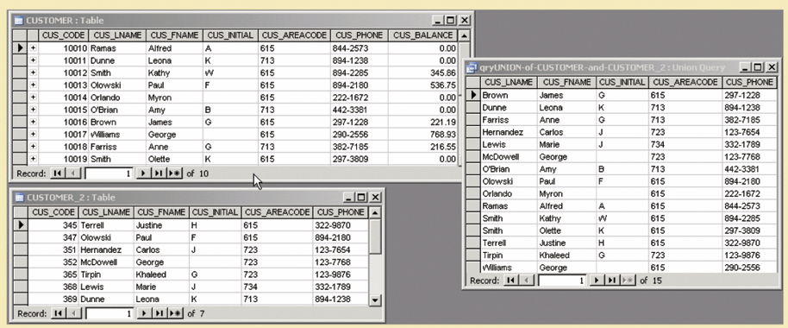
UNION
Combines rows from two or more SELECT queries without including duplicate rows .
Syntax of the UNION statement is: query UNION query.
SELECT statements must be union-compatible. They must return the same number of attributes and similar data types
SELECT CUS_LNAME, CUS_FNAME, CUS_INITIAL,
CUS_AREACODE, CUS_PHONE
FROM CUSTOMER
UNION SELECT CUS_LNAME, CUS_FNAME, CUS_INITIAL,
CUS_AREACODE, CUS_PHONE
FROM CUSTOMER_2;
7
Notes:
Suppose that SaleCo has bought another company. SaleCo’s management wants to make sure that the acquired company’s customer list is properly merged with its own customer list. Because some customers might have purchased goods from both companies, the two lists might contain common customers. SaleCo’s management wants to make sure that customer records are not duplicated when the two customer lists are merged. The UNION query is a perfect tool for generating a combined listing of customers.

Slide 8
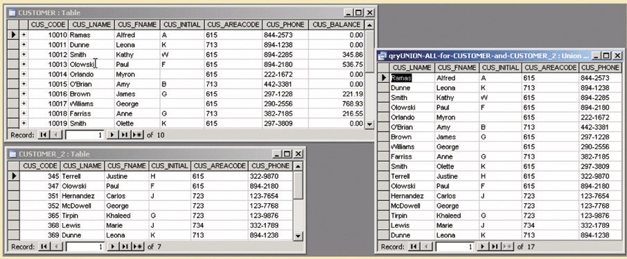
UNION ALL
UNION ALL query can be used to produce a relation that retains the duplicate rows.
SELECT CUS_LNAME, CUS_FNAME, CUS_INITIAL,
CUS_AREACODE, CUS_PHONE
FROM CUSTOMER
UNION ALL SELECT CUS_LNAME, CUS_FNAME, CUS_INITIAL,
CUS_AREACODE, CUS_PHONE
FROM CUSTOMER_2;
8
Notes:
If SaleCo’s management wants to know how many customers are on both the CUSTOMER and CUSTOMER_2 lists….

Slide 9
INTERSECT
INTERSECT statement can be used to combine rows from two queries, returning only the rows that appear in both sets.
Syntax for the INTERSECT statement is query INTERSECT query
It generates the list of duplicate customer records.
INTERSECT is not supported by MYSQL.
SELECT CUS_CODE
FROM CUSTOMER
WHERE CUS_AREACODE = ‘615’
INTERSECT SELECT DISTINCT CUS_CODE
FROM INVOICE;
Some DBMS does not support INTERSECT query , here is an alternative.
SELECT CUS_CODE
FROM CUSTOMER
WHERE CUS_AREACODE = '615‘
AND CUS_CODE IN (SELECT DISTINCT CUS_CODE FROM INVOICE);
9
Notes:
If SaleCo’s management wants to know which customer records are duplicated in the CUSTOMER and CUSTOMER_2 tables, the INTERSECT statement can be used…
the following query returns the customer codes for all customers who are in area code 615 and who have made purchases. (If a customer has made a purchase, there must be an invoice record for that customer.)

Slide 10
MINUS
The MINUS / EXCEPT statement in SQL combines rows from two queries and returns only the rows that appear in the first set but not in the second.
EXCEPT is not supported by MYSQL.
SELECT CUS_LNAME, CUS_FNAME, CUS_INITIAL,
CUS_AREACODE, CUS_PHONE
FROM CUSTOMER
MINUS SELECT CUS_LNAME, CUS_FNAME, CUS_INITIAL,
CUS_AREACODE, CUS_PHONE
FROM CUSTOMER_2;
SELECT CUS_CODE
FROM CUSTOMER
WHERE CUS_AREACODE = ‘615’
MINUS SELECT DISTINCT CUS_CODE
FROM INVOICE;
Some DBMS does not support MINUS query , here is an alternative.
SELECT CUS_CODE
FROM CUSTOMER
WHERE CUS_AREACODE = '615'
AND CUS_CODE NOT IN (SELECT DISTINCT CUS_CODE FROM INVOICE);
10
Notes:
If the SaleCo managers want to know which customers in the CUSTOMER table are not found in the CUSTOMER_2 table….
The following query returns the customer codes for all customers in area code 615 minus the ones who have made purchases, leaving the customers in area code 615 who have not made purchases.

Slide 11
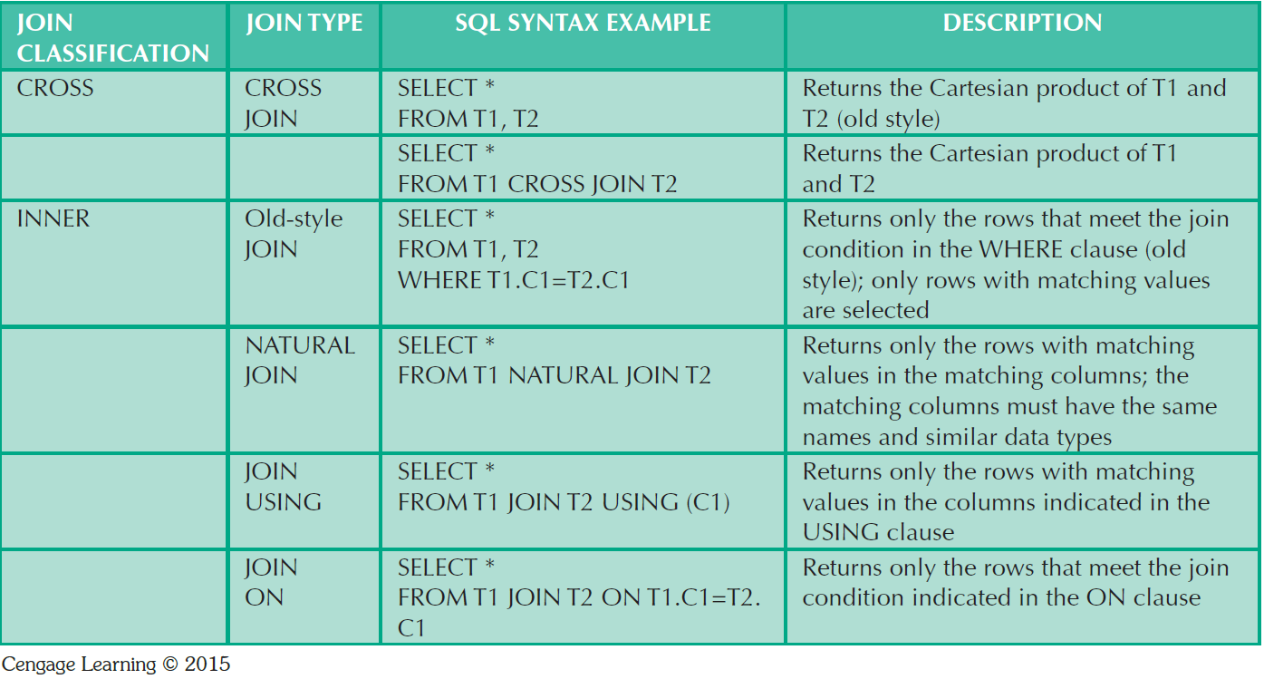
SQL Join Operators
11

Slide 12
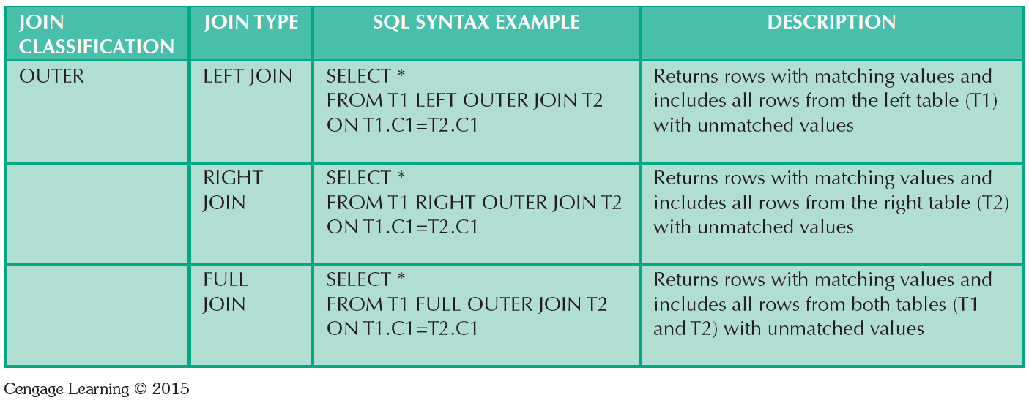
SQL Join Operators
12

Slide 13
“old-style” vs. other styles of Join
“old-style”
SELECT P_CODE,P_DECRIPT, P_PRICE,V_NAME FROM PRODUCT, VENDOR
WHERE PRODUCT.V_CODE=VENDOR.V_CODE;
Natural Join
SELECT P_CODE,P_DECRIPT, P_PRICE,V_NAME FROM PRODUCT NATURAL JOIN VENDOR;
Join On
SELECT P_CODE,P_DECRIPT, P_PRICE,V_NAME FROM PRODUCT JOIN VENDOR ON PRODUCT.V_CODE=VENDOR.V_CODE ;
Join Using
SELECT P_CODE,P_DECRIPT, P_PRICE,V_NAME FROM PRODUCT JOIN VENDOR USING (V_CODE);
13

Slide 14
Cross Join
Used to generate a paired combination of each row of the first table with each row of the second table
Returns the result that contains every row from all contributing tables.
All rows present in the first table multiplied by all rows present in the second table.
Similar to the Inner Join, where the join condition is not included.
Cross join performs a relation product (Cartesian product)‏
Syntax:
SELECT column-list FROM table1 CROSS JOIN table2
same results
as
SELECT * FROM INVOICE CROSS JOIN LINE;
SELECT INVOICE.INV_NUMBER, CUS_CODE,
INV_DATE, P_CODE FROM INVOICE CROSS JOIN LINE;
SELECT INVOICE.INV_NUMBER, CUS_CODE,
INV_DATE, P_CODE FROM INVOICE, LINE;
14

Slide 15
Natural Join
Natural join returns only the rows with matching values in the matching columns and eliminates duplicate columns
SELECT CUS_CODE, CUS_LNAME, INV_NUMBER, INV_DATE
FROM CUSTOMER NATURAL JOIN INVOICE
SELECT INV_NUMBER, P_CODE, P_DESCRIPT, LINE_UNITS, LINE_PRICE
FROM INVOICE NATURAL JOIN LINE NATURAL JOIN PRODUCT;
Determines the common attribute(s) by looking for attributes with identical names and compatible data types.
If there are no common attributes, returns the relational product of the 2 tables .
15
Notes:
This style of query is used when the tables share one or more common attributes with common names.

Slide 16
JOIN USING Clause
Join USING clause returns only the rows with matching values in the column indicated in the USING clause.
Column must exist in both tables.
Identical names for matched columns in both tables.
Can use even 2 JOIN-USING in one sql statement.
SELECT INV_NUMBER, P_CODE, P_DESCRIPT, LINE_UNITS, LINE_PRICE
FROM INVOICE JOIN LINE USING (INV_NUMBER);
SELECT INV_NUMBER, P_CODE, P_DESCRIPT, LINE_UNITS, LINE_PRICE
FROM INVOICE JOIN LINE USING (INV_NUMBER) JOIN PRODUCT USING (P_CODE);
16

Slide 17
JOIN ON Clause
When the tables have no common attribute names, we need to use the JOIN ON operand.
The columns may or may not share the same name, but they must have comparable data types.
SELECT INVOICE.INV_NUMBER, P_CODE, P_DESCRIPT, LINE_UNITS, LINE_PRICE
FROM INVOICE JOIN LINE ON INVOICE.INV_NUMBER = LINE.INV_NUMBER
JOIN PRODUCT ON LINE.P_CODE = PRODUCT.P_CODE;
SELECT EMP.EMP_NUM, EMP.MGR, MAN.EMP_LNAME,
FROM EMP JOIN MAN ON EMP.MGR = MAN.EMP_NUM
ORDER BY EMP.MGR;
17

Slide 18
Outer Joins
Returns not only matching rows, but also rows with unmatched attribute values for one table (LEFT or RIGHT) or both tables (FULL) to be joined.
The left and right designations reflect the order in which the tables are processed by the DBMS
SELECT P_CODE, VENDOR.V_CODE, V_NAME
FROM VENDOR LEFT JOIN PRODUCT ON VENDOR.V_CODE = PRODUCT.V_CODE;
Left outer join
SELECT P_CODE, VENDOR.V_CODE, V_NAME
FROM VENDOR RIGHT JOIN PRODUCT ON VENDOR.V_CODE = PRODUCT.V_CODE;
Right outer join
SELECT P_CODE, VENDOR.V_CODE, V_NAME
FROM VENDOR FULL JOIN PRODUCT ON VENDOR.V_CODE = PRODUCT.V_CODE;
Full outer join
18
Notes:
The left outer join returns not only the rows matching the join condition (that is, rows with matching values in the common column), but it also returns the rows in the left table with unmatched values in the right table.
The right outer join returns not only the rows matching the join condition (that is, rows with matching values in the common column), but it also returns the rows in the right table with unmatched values in the left table.
The full outer join returns not only the rows matching the join condition (that is, rows with matching values in the common column), but it also returns all of the rows with unmatched values in the table on either side.
MySQL doesn't offer syntax for a full outer join, but you can implement one using the union of a left and a right join.
SELECT * FROM t1 LEFT JOIN t2 ON t1.id = t2.id UNION SELECT * FROM t1 RIGHT JOIN t2 ON t1.id = t2.id

Slide 19
SQL Functions for DATE variable
List all employees born in 1966,
List all employees born in November,
List all employees born on the 14th day of the month,
SELECT EMP_LNAME, EMP_FNAME, EMP_DOB, YEAR(EMP_DOB) AS ‘Birth Year’
FROM EMPLOYEE
WHERE YEAR(EMP_DOB) = 1966;
SELECT EMP_LNAME, EMP_FNAME, EMP_DOB, MONTH(EMP_DOB) AS ‘Birth Month’
FROM EMPLOYEE
WHERE MONTH(EMP_DOB) = 11;
SELECT EMP_LNAME, EMP_FNAME, EMP_DOB, DAY(EMP_DOB) AS ‘Birth Day’
FROM EMPLOYEE
WHERE DAY(EMP_DOB) = 14;
19
Notes:
https://dev.mysql.com/doc/refman/8.0/en/date-and-time-functions.html
mysql> SELECT MONTH('2008-02-03'); -> 2

Slide 20
Useful SQL Functions
How many days are left until Christmas?
DATEDIFF
CONCAT
ROUND
Refer to the sample solution SQL codes provided in Practical 7 and Practical 8
SELECT DATEDIFF(‘2022-12-25’, SYSDATE());
20

Slide 21
Subqueries
We can use subquery to generate the required information that could then be used as input for the originating query
The basic characteristics of a subquery,
A query (SELECT statement) inside a query
Normally expressed inside parentheses
Consisted of outer and inner queries
Inner query is executed first
Output of inner query is used as the input for the outer query
Entire SQL statement is a nested query
21
Notes:
In JOIN queries, the data from both tables is processed at once, using matched values.
However, it is often necessary to process data based on other processed data. So, subquery.

Slide 22
Examples of Subqueries
Insert all row from Table P into the PRODUCT table. Both tables must have the same attributes.
The subquery returns all rows from Table P.
Another example,
INSERT INTO PRODUCT
SELECT * FROM P;
Outer Query
Inner Query (returns a virtual table)‏
Inner Query (returns a single value)‏
UPDATE PRODUCT
SET P_PRICE=(SELECT AVG(P_PRICE) FROM PRODUCT)‏
WHERE V_CODE IN (SELECT V_CODE
FROM VENDOR
WHERE V_AREACODE=‘615’)‏
Inner Query (returns a list of values
22

Slide 23
Examples of Subqueries
Deletes the PRODUCT table rows that are provided by vendors with area-code equal to 615.
DELETE FROM PRODUCT
WHERE V_CODE IN
( SELECT V_CODE
FROM VENDOR
WHERE V_AREACODE=‘615’);
23

Slide 24
Examples of Subqueries
Find all products with a price greater than or equal to the average product price,
SELECT P_CODE, P_PRICE
FROM PRODUCT
WHERE P_PRICE >=
( SELECT AVG(P_PRICE)
FROM PRODUCT);
24

Slide 25
WHERE Subqueries and JOINS
List all of the customers who ordered the product “Claw hammer”.
SELECT DISTINCT CUS_CODE, CUS_LNAME, CUS_FNAME
FROM CUSTOMER JOIN INVOICE USING (CUS_CODE)‏
JOIN LINE USING (INV_NUMBER)‏
WHERE P_CODE =
( SELECT P_CODE
FROM PRODUCT
WHERE P_DESCRIPT = 'Claw hammer');
Alternative way
SELECT DISTINCT CUS_CODE, CUS_LNAME, CUS_FNAME
FROM CUSTOMER JOIN INVOICE USING (CUS_CODE)‏
JOIN LINE USING (INV_NUMBER)
JOIN PRODUCT USING (P_CODE)‏
WHERE P_DESCRIPT = 'Claw hammer';
25

Slide 26
IN Subqueries
List all customer who have purchased hammers or saws or saw blades.
SELECT DISTINCT CUS_CODE, CUS_LNAME, CUS_FNAME
FROM CUSTOMER JOIN INVOICE USING (CUS_CODE)‏
JOIN LINE USING (INV_NUMBER)
JOIN PRODUCT USING (P_CODE)‏
WHERE P_CODE IN (SELECT P_CODE
FROM PRODUCT
WHERE P_DESCRIPT LIKE '%hammer%'
OR P_DESCRIPT LIKE '%saw%');
26
Notes:
you need to compare the P_CODE not to one product code (a single value) but to a list of product code values.
When you want to compare a single attribute to a list of values, you use the IN operator.

Slide 27
HAVING Subqueries
List all products with the total quantity sold greater than the average quantity sold,
SELECT P_CODE, SUM(LINE_UNITS)‏
FROM LINE
GROUP BY P_CODE
HAVING SUM(LINE_UNITS) > (SELECT AVG(LINE_UNITS)
FROM LINE);
27
Notes:
The HAVING clause is used to restrict the output of a GROUP BY query by applying conditional criteria to the grouped rows.

Slide 28
Multirow Subquery Operators: ANY and ALL
List products having a product cost that is greater than all individual product cost for products provided by vendors from Florida,
SELECT P_CODE, P_QOH*P_PRICE
FROM PRODUCT
WHERE P_QOH*P_PRICE > ALL ( SELECT P_QOH*P_PRICE FROM PRODUCT
WHERE V_CODE IN
(SELECT V_CODE
FROM VENDOR
WHERE V_STATE = 'FL'));
How about changing ALL to ANY ?
28
Notes:
The ANY keyword, which must follow a comparison operator, means “return TRUE if the comparison is TRUE for ANY of the values in the column that the subquery returns.”
The word ALL, which must follow a comparison operator, means “return TRUE if the comparison is TRUE for ALL of the values in the column that the subquery returns.”

Slide 29
FROM Subqueries
List all customer who purchased products 13-Q2/P2 and 23109-HB
SELECT DISTINCT CUSTOMER.CUS_CODE, CUSTOMER.CUS_LNAME
FROM CUSTOMER,
(SELECT INVOICE.CUS_CODE
FROM INVOICE NATURAL JOIN LINE
WHERE P_CODE = '13-Q2/P2') CP1,
(SELECT INVOICE.CUS_CODE
FROM INVOICE NATURAL JOIN LINE
WHERE P_CODE = '23109-HB') CP2
WHERE CUSTOMER.CUS_CODE = CP1.CUS_CODE
AND CP1.CUS_CODE = CP2.CUS_CODE;
29
Notes:
The ANY and ALL operators are used for multi­ row subqueries. In all of those cases, the subquery was part of a conditional expression (ie. WHERE clause), and it always appeared at the right side of the expression.
In this section, you will learn how to use subqueries in the FROM clause.

Slide 30
Attribute List (SELECT) Subqueries
The SELECT statement uses the attribute list, which can be columns of base tables, computed attributes, or the result of an aggregate function.
The attribute list can also include a subquery expression, also known as an inline subquery .
A subquery in the attribute list must return one value; otherwise, an error code is raised.
Eg : List the difference between each product’s price and the average product price
SELECT P_CODE, P_PRICE,
(SELECT AVG(P_PRICE) FROM PRODUCT) AS AVGPRICE,
P_PRICE-(SELECT AVG(P_PRICE) FROM PRODUCT) AS DIFF
FROM PRODUCT;
30
Notes:
SELECT P_CODE, SALES, ECOUNT, SALES/ECOUNT AS CONTRIB
FROM (SELECT P_CODE, SUM(LINE_UNITS*LINE_PRICE) AS SALES,
(SELECT COUNT(*) FROM EMPLOYEE) AS ECOUNT
FROM LINE GROUP BY P_CODE);

Slide 31
Correlated Subqueries
Correlated subquery is a subquery that executes once for each row in the outer query
Eg: Suppose you want to know all product sales in which the units sold value is greater than the average units sold value for that product (not all product),then you need to,
Compute the average-unit-sold value for a product
Compare the average computed in Step 1 to the unit sold in each sale row, then select only the rows in which the number of units sold is greater then the average
31
Notes:
Until now, all subqueries you have learned execute independently. That is, each subquery in a command sequence executes in a serial fashion, one after another. The inner subquery executes first; its output is used by the outer query, which then executes until the last outer query finishes (the first SQL statement in the code).
Correlated subquery - The process is similar to the typical nested loop in a programming language.
Correlated subqueries can also be used with the EXISTS special operator.
The EXISTS special operator can be used whenever there is a requirement to execute a command based on the result of another query.
If a subquery returns any rows, run the main query; otherwise, do not.

Slide 32
Correlated Subqueries
SELECT INV_NUMBER, P_CODE, LINE_UNITS
FROM LINE LS
WHERE LS.LINE_UNITS >
( SELECT AVG(LINE_UNITS)
FROM LINE LA
WHERE LA.P_CODE = LS.P_CODE);
Called a correlated subquery because the inner query is related to the outer query; the inner query references a column of the outer subquery.
A correlated subquery cannot be executed independently as a simple subquery.
A correlated subquery depends on the outer query.
32
Notes:
SELECT INV_NUMBER, P_CODE, LINE_UNITS,
(SELECT AVG(LINE_UNITS) FROM LINE LX WHERE LX.P_CODE = LS.P_CODE) AS AVG
FROM LINE LS
WHERE LS.LINE_UNITS >
( SELECT AVG(LINE_UNITS)‏
FROM LINE LA
WHERE LA.P_CODE = LS.P_CODE);

Slide 33
EXISTS Correlated Subqueries
List all customers who has made purchases
SELECT CUS_CODE, CUS_LNAME, CUS_FNAME
FROM CUSTOMER
WHERE EXISTS
(SELECT CUS_CODE
FROM INVOICE
WHERE INVOICE.CUS_CODE = CUSTOMER.CUS_CODE);
SELECT CUS_CODE, CUS_LNAME, CUS_FNAME
FROM CUSTOMER
WHERE CUS_CODE IN
(SELECT CUS_CODE
FROM INVOICE);
33

Slide 34
EXISTS Correlated Subqueries
List all vendors to contract for products with a qty on hand <= double P_MIN?
SELECT V_CODE, V_NAME
FROM VENDOR
WHERE EXISTS
( SELECT *
FROM PRODUCT
WHERE P_QOH<=P_MIN*2
AND VENDOR.V_CODE = PRODUCT.V_CODE);
SELECT V_CODE, V_NAME
FROM VENDOR JOIN PRODUCT USING (V_CODE)
WHERE P_QOH<=P_MIN*2
34

Slide 35
Summary
SQL provides relational set operators to combine output of two queries to generate new relation
Operations that join tables can be classified as inner joins and outer joins
There are three different types of outer joins namely left outer join, right outer join and full outer join.
Subquery can put place in different clause of the SQL statement.
The inner query will be executed first
The inner query returns the output, which will be used by the outer query
Correlated subquery os a subquery that executes once for each row in the outer query

